Slide 1


Data Pre-processing
In collaboration with N8
4th May, 2023
13:30-15:30
Copyright © year Institution. Created by Organisation, UK Data Service.

Slide 2
Table of contents
What is pre-processing?
Integration
Cleaning
Reduction
Transformation

Slide 3
What is data pre-processing?

Slide 4
Definition
Data pre-processing (a.k.a. data preparation) is important to any data anylitics project.
Data pre-processing = turning raw data -> analysis-ready data.
Probably through integration, description, summarisation, visualisation, cleaning, reduction, transformation, discretization, generalisation, anonymisation and potentially more.
Importantly, there is no standard set of steps or order to follow
Notes:
Includes various tasks and considerations such as
- Selecting and acquiring data to use
- Integrating different data sources together
- Conducting exploratory analysis
- Cleaning/repairing data, e.g., missing data, inconsistent data
- Data reduction, transformation, etc.
Data integration - integration of multiple databases, data cubes, or files
Data description, summarisation and visualisation
Data cleaning - fill in missing values, smooth noisy data, identify or remove outliers and noisy data, and resolve inconsistencies
Data reduction - obtain reduced representation in volume but produces the same or similar analytical results
Data transformation - normalisation and aggregation
Data discretisation (for numerical data) and generalisation

Slide 5
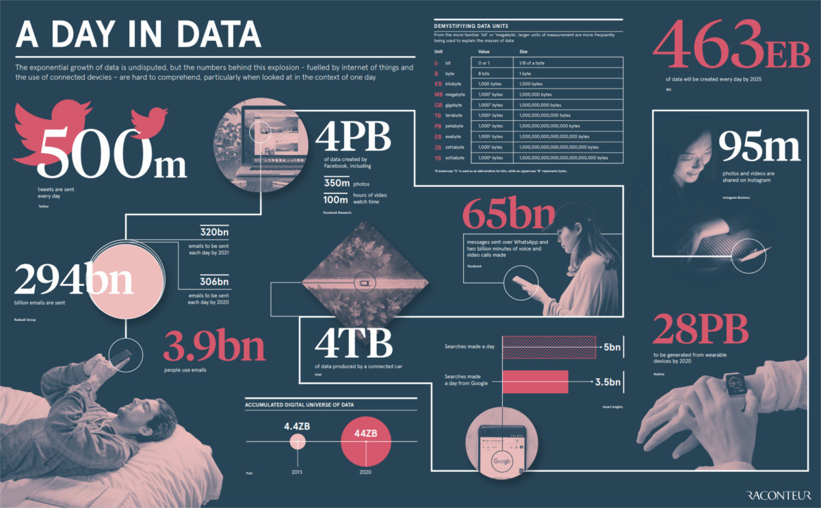
The context
Notes:
Working in data could be ‘the sexiest job in the world in the 21st century’ and the volume and speed of data is increasing in an amazing, even alarming way.
But the insights and value do not come from pure volume, which is often just overwhelming.
Instead, the value comes from using the good data well. What does that mean?

Slide 6

Garbage in, garbage out
Raw data is like a heap of household waste
Lots of value, but most valuable if sorted, graded, cleaned, identified, etc. that just a single big pile of any old stuff.
This Photo by Unknown Author is licensed under CC BY-SA
Notes:
A big pile of random stuff will have some items that are valuable for some users. But those users will get more value if that same big pile is first sorted, cleaned, graded, labelled, etc.
This is why we sort our household waste into bags for charity shop donations, glass recycling, paper recycling, green waste, etc. The value of each of those things is greater after some pre-processing work is done.

Slide 7
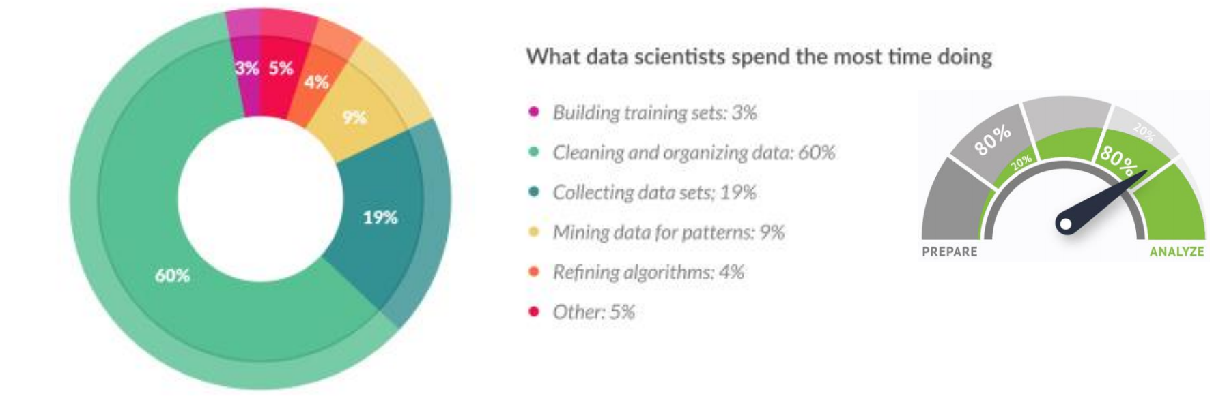
Data preparation is 80% of data science work
Notes:
Forbes found that “Data preparation accounts for about 80% of the work of data scientists”.
In particular, 19% is spent on collecting data sets and 69% is spent on cleaning and organising data. and other tasks like xx are very little in comparison.

Slide 8
Collecting data
Generate own data
Scrape from websites/API’s
From third-party platforms, e.g. Statista, World Bank, UKDS
Capture actions from automated processes
Others?
Notes:
Among others, the source of data is very crucial to determine the data quality from the very beginning
There are many ways to collect the data.
If you run your own business which generates data itself, then you might think about build a data warehouse to store the data and organise it as you wish, and the data can be easily retrieved when needed. But that usually costs a lot.
Or, you can scrape data from a website to collect the raw data yourself. that usually takes longer time to pre-process it as the data tends to be dirty. E.g. the price may be shown as a piece of text rather than a number as as you want. But the good point is that you can customise the data structure while collecting the data.
Alternatively, you can use the ready-made data sources. E.g.Statista which is usually for business data, and also World Bank, UKDS.

Slide 9
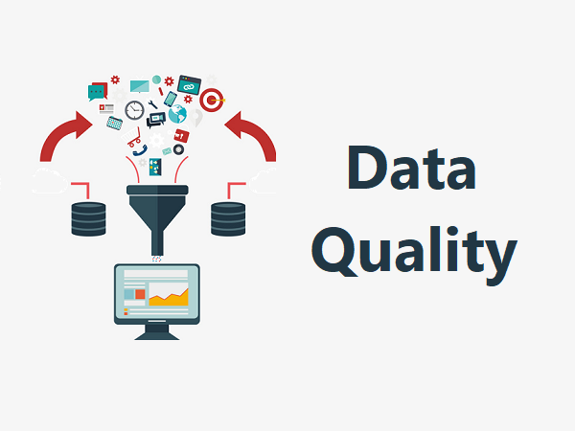
Always check data
Meta data: “data about data”
Understanding data availability, types, quantity, complexity, etc.
Exploratory Data Analysis (EDA)
Analyzing data sets to summarize their main characteristics, often with visual methods.
Notes:
There are many ways to check the your data, to verify its quality but also to understand its “shape”. There are many ways, but 2 common ones are:
Read the documentation and look at the metadata, which is the “data about data”
The Motivation is to better understand the data, including its availability, types, quantity, complexity, among others. Metadata means different things to different data users, so always read the documentation carefully and ask questions if it is not clear.
Another is one Exploratory Data Analysis (EDA). EDA is widely used in data analytics and one of its functions is to check data quality. It is An approach to analyzing data sets to summarize their main characteristics, often with visual methods. EDA is primarily for seeing what the data can tell us before the formal modeling or hypothesis testing task
e.g. if I have sales at hand and I want to build a model to predict the performance of next month, then maybe I’ll start with EDA to do some random exploration, such as creating histograms to see whether there are any region stands out from the rest or if weekends have clear higher income.

Slide 10
Integration

Slide 11
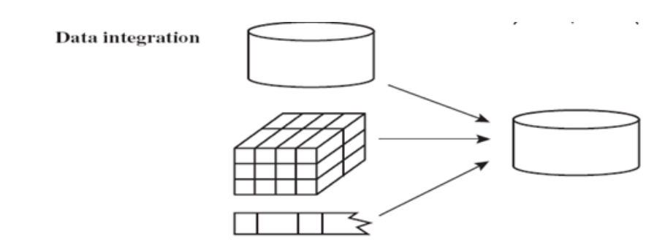
Data Integration
Combining data from multiple sources to:
- improve data quality
- enrich data with additional information
- allow reliable data analytics and beyond
Notes:
It is not common that all information will be stored in one spreadsheet because not all of the same data comes from the same sources, is created by the same processes, is updated at the same rates, etc.
For example, a doctor’s surgery might have a relatively static list of their patients with name address, age, conditions, repeat prescriptions, risk profiles, etc. which are created at patient intake and updated by the reception staff and/or the patients themselves.
Then, they’ll have a much more dynamic list of appointments created by their booking software or scheduling algorithms.
If we want to make sure that doctors are not being presented with patients or conditions outside their skill set then we need to link these tables and make more complex, integrated data.

Slide 12
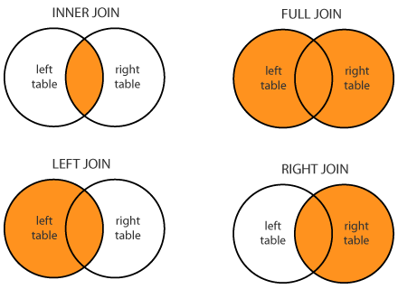
Joining
Which join to use = question to answer + data available
Notes:
There are four types of join with the choice depending on what you want to accomplish and what you have to work with.
Always check data after joining.
These are usually understood as ways to make a single data set WIDER, which will make more sense in the examples I give next.

Slide 13
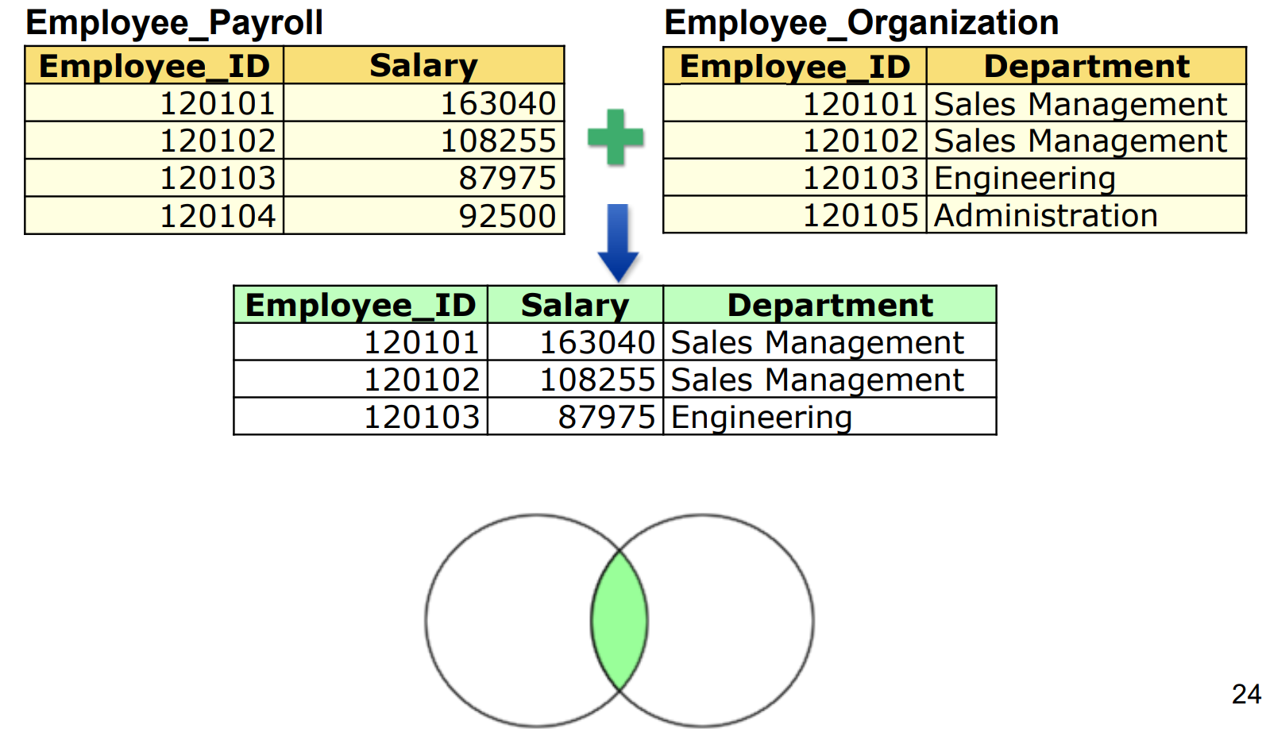
Inner join
Notes:
Usually considered the “default” join, an inner join returns the contents of both tables only for those rows that match between tables.

Slide 14
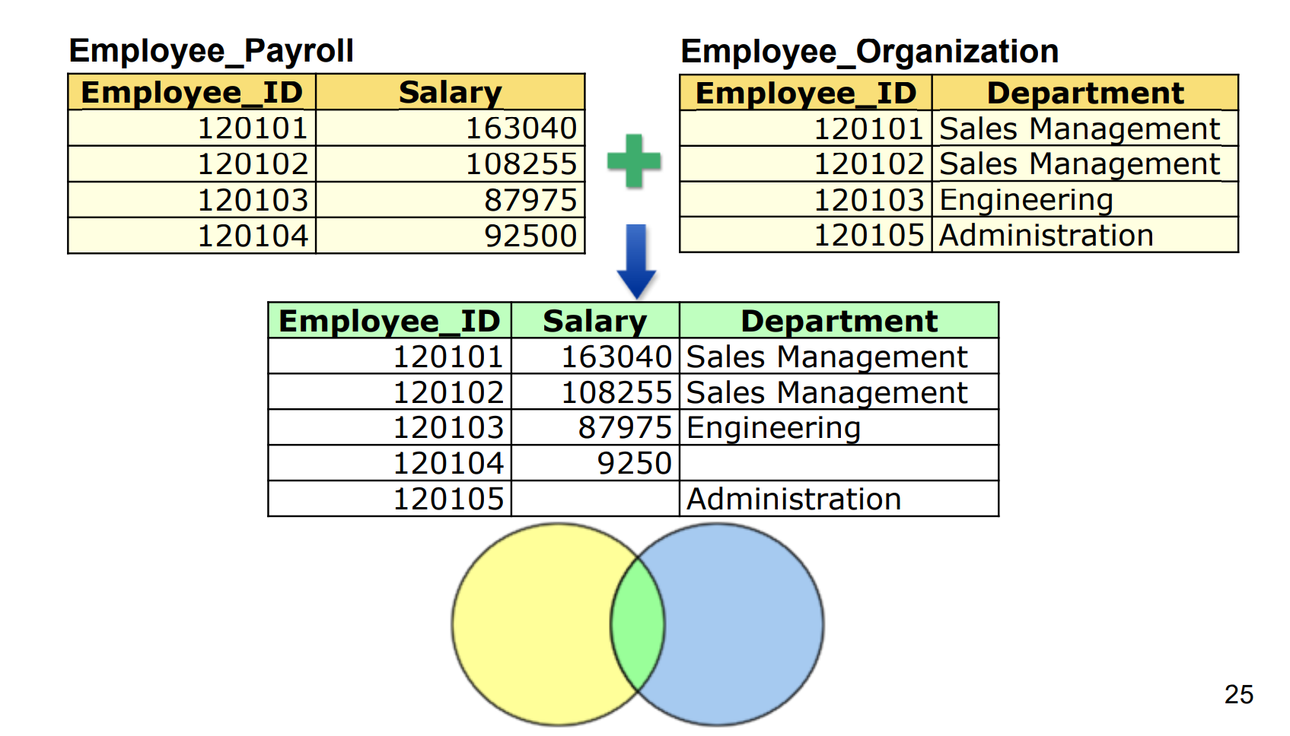
Outer join
92500
Notes:
A full outer join includes all rows from both tables, necessarily introducing null values or missing values when there are rows in one table that do not match a row in the other.

Slide 15
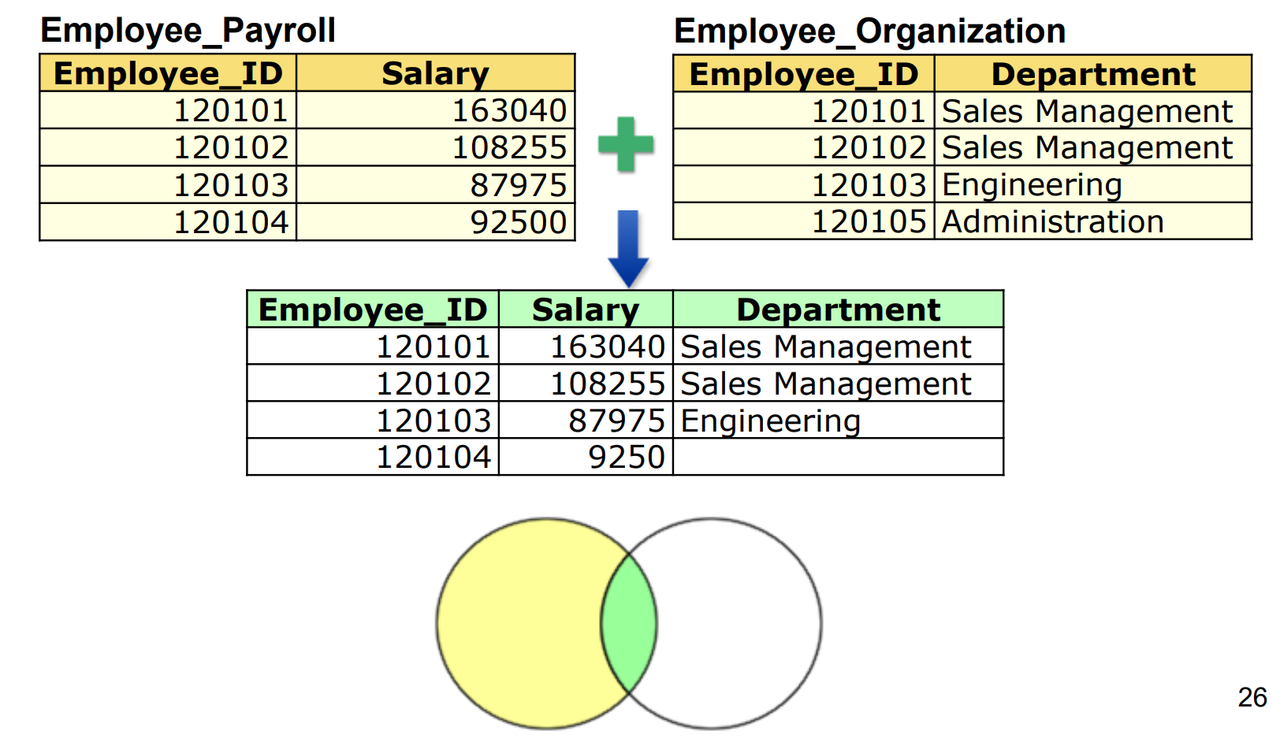
Left join
92500
Notes:
A left join includes all rows from the left table and all the contents of the right table for those rows that have a match between tables.
This method is sensitive to the order of the table in the command. Be careful on which table you put first.
A right join works exactly like a left join, but logically, contains the whole right table. Again, this is sensitive to the order of the table in the command.

Slide 16

Joining difficulties
Database heterogeneity
System Heterogeneity: different operating system, hardware platforms
Schematic or Structural Heterogeneity: the native model or structure to store data
Data value conflicts
E.g., metric vs. British units
Entity identification
E.g., Bill Clinton = William Clinton
Notes:
Data integration is not an easy job, as there are many difficulties.
First is Database heterogeneity, including System Heterogeneity and schematic heterogeneity.
System het occurs when using different operating system, hardware platforms
And Schematic or Structural Heterogeneity refers to cases where the native model or structure to store data differ in data sources, e.g SQL vs no SQL
The Second issue is about detecting and resolving data value conflicts.
For the same real-world entity, attribute values from different sources are different, including different representations, different scales, e.g., metric vs. British units
Last not least is on Entity identification.
When integrating data, we may need to identify entities from multiple data sources, but the same entity or attribute may have different names in different databases, e.g., Bill Clinton = William Clinton
We will discuss this later in data linkage

Slide 17

Example – Health Surveillance
Various databases
Many millions of records
Privacy and confidentiality concerns
Preventing the outbreak of epidemics requires monitoring of occurrences of unusual patterns of symptoms (in real time!)
Notes:
A vivid example is the health surveillance systems.
Preventing the outbreak of epidemics requires monitoring of occurrences of unusual patterns of symptoms (in real time!)
Data from many different sources need to be collected (including travel and immigration records; doctors, emergency and hospital admissions; drug purchases in pharmacies; animal health data; etc.)
Such databases can have different formats and codings, and they usually contain data of different quality
Volume is one issue, as they can contain many millions of records.
Also another issue is privacy and confidentiality, if such data are stored and linked at a central location and without proper regulations

Slide 18

Linking Data
Data linkage is the process of bringing together information from two different records that are believed to belong to the same entity based on matching variables.
Deterministic linkage – 100% agree on key e.g. ID number
Probabilistic linkage – over threshold agree on several features (e.g. name, date of birth, start date, etc.)
Notes:
Another two part of data integration is data linkage and data enrichment which brings together information from two different records that are believed to belong to the same entity based on matching variables. It is also known as record linkage, data matching, entity identification, etc.
Beyond just joining, which made a single data table wider, linking can be understood as deepening data that is may not be stored in a single table. For example, if we had a patient record with one doctor, and the patient moved to a new city and registered with a new doctor, there may come a time that the two doctors surgeries want to merge records. But they don’t want to just create a single big table with one row per patient that has loads of columns for addresses. Instead, they probably want to keep the current address in a privileged or prominent position while potentially also retaining past addresses in less accessible but time stamped records.
This sort of linkage is relatively more complicated and not always need, so I won’t go deep into it. But I think it’s always good to know them in case you may encounter it in some days.
It is a challenging task if there are errors in the key variables that are used to link the data

Slide 19
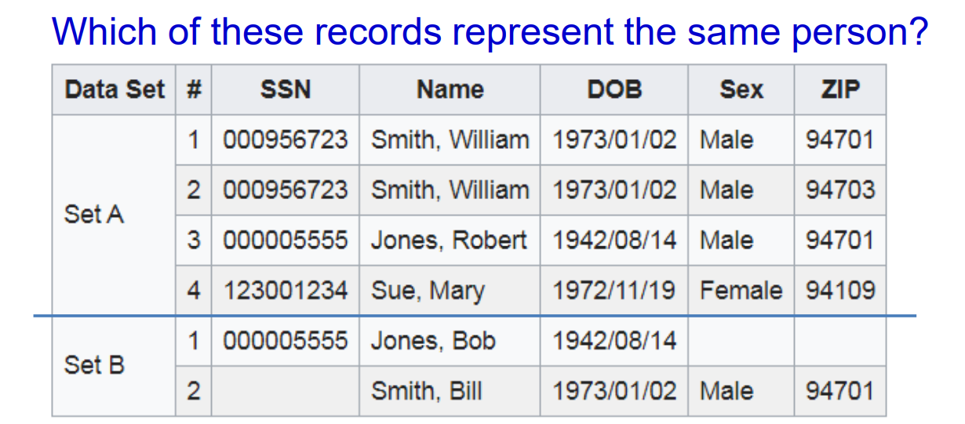
Linking Data
Notes:
e.g.
Based on Deterministic linkage, we can set SSN as the reference. Row 1 in set B will be assigned to Row 3 in set A. But Row 2 in set B will fail to find a match.
And if adopting Probabilistic linkage, we need find row 2 in set B is a replication of row 1 in set A, as they share same DOB, Sex and ZIP, although the name is name is not exactly the same.

Slide 20
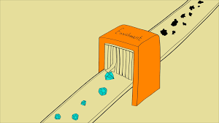
Enriching Data
Data enrichment: the process of introducing more data from other internal sources or third-party external data
Provide context with additional data to enrich or validate the data
Notes:
Data enrichment is the process of introducing more data.
It can be disparate data from other internal sources, or third party data from external sources.
The benefits is that, first, it can provide contextualization with additional data, and second, it helps enrich or validate our data
For example: to get a better understanding of advertising effectiveness, a company can enrich internal sales data with third party advertisement data
Enriched data is a valuable asset for any organization because it becomes more useful and insightful.
A majority of brands conduct data enrichment on their raw data so that they can use it to make informed decisions. In 2018, data enrichment grew by 80%

Slide 21
Cleaning

Slide 22
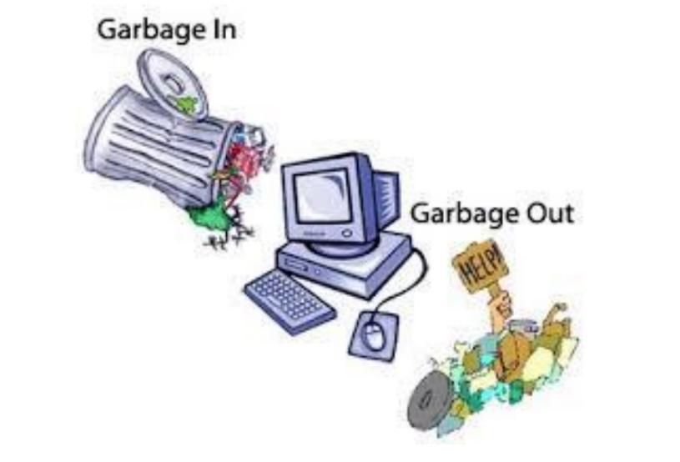
Why Data Cleaning?
“Data cleaning is one of the three biggest problems in data warehousing”— Ralph Kimball
“Data cleaning is the number one problem in data warehousing”— DCI survey
Quality data beats fancy data mining algorithms
Notes:
So why data cleaning? Well it’s been acknowledged that xx, xx, and xx.
We do data cleaning to avoid what data scientists call as GIGO, which stands for xx.

Slide 23

Quality Issues
Real world data is dirty:
Incomplete or missing: lacking attribute values or certain attributes of interest, or containing only aggregate data,
e.g., occupation=“ ” (missing data) or “too many” Jan 1 birthdays (introduced as null value when otherwise missing)
Inaccurate or noisy: containing errors or outliers,
e.g., salary=“-10” (an error)
Inconsistent: containing discrepancies in codes or names,
e.g., age = “42” and birthday=“03/07/1997”
Notes:
Data quality can be reviewed from multiple dimensions. Whether the data is complete, whether the data is accurate, whether the data is consistent. So on and so forth.
In this sense, Data in the real world is often dirty, e.g., it can miss certain attribute values or even certain attributes, or containing only aggregate data,
e.g., occupation could be empty, or a less obvious example is that Jan. 1 as everyone’s birthday
And also Inaccurate or noisy which means data contain errors or outliers,
e.g., salary as a negative value which is very questionable
It can also be Inconsistent when data contain discrepancies in codes or names,
e.g., when age = “42” but birthday indicates the entity was born in 1997

Slide 24
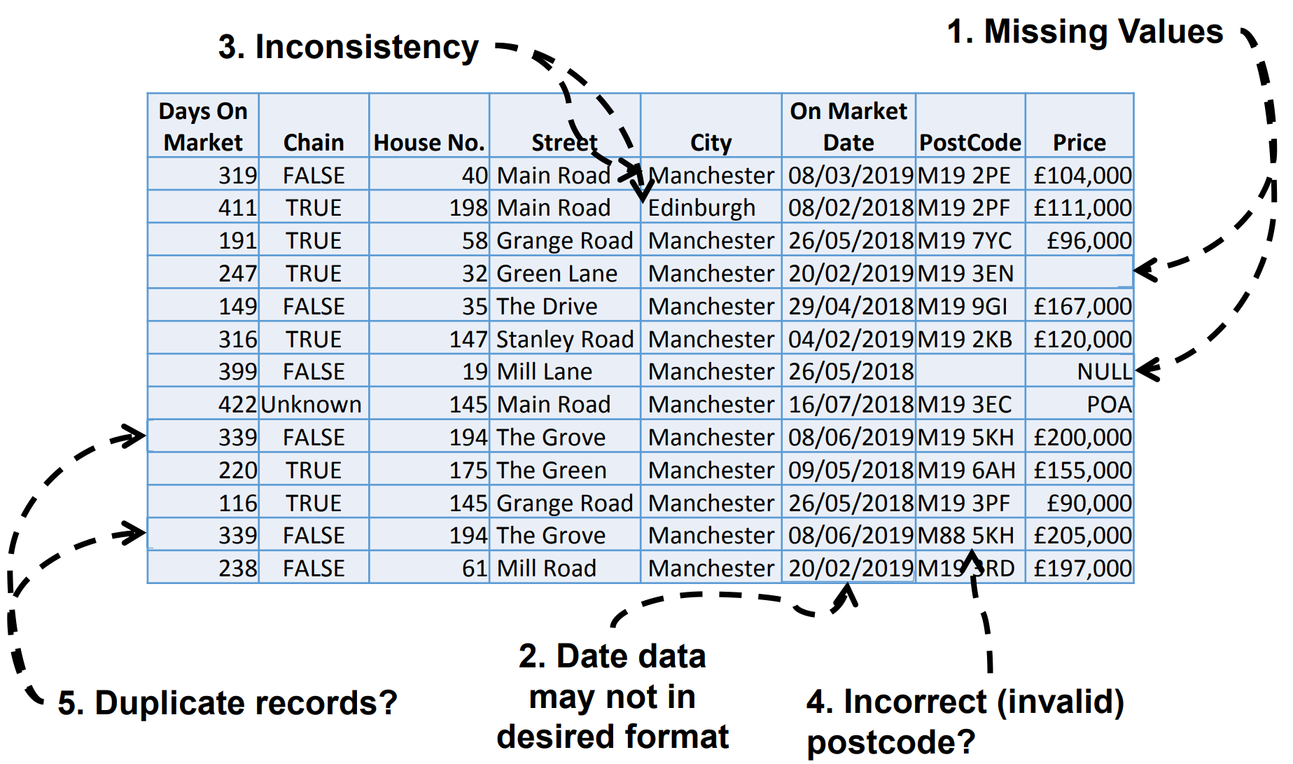
Dirty Data – Example
p54
Notes:
Here is an example of a very dirty dataset,
Missing values, some shown as null, some as unknown, and some is just empty
Date column may not in the desired format if we want to show month first and then date and year
If this is a report for Manchester only, and we have the postcode and streetname for Manchester, then the Edinburgh here is definitely an error
Also the postcode M88 doesn’t sound very reliable
And if take a closer look, two rows seems to belong to the same entity
If we put this data directly into use, then it’s not likely to get useful and accurate results

Slide 25

No Easy Fix for Missing Values
Throw out the records with missing values?
■ No? This creates a bias for the sample
Delete the column with missing values?
■ No? Only if the column data is unnecessary
Replace missing values with a “special” value (e.g., -99)?
■ No. This resembles any other value to data analytics.
Replace with some “typical” value? mean, median, or mode?
■ Maybe. Possible changes to the distribution.
Impute a value? (Imputed values should be flagged.)
■ Maybe. Use distribution of values to randomly choose a value.
Use data mining techniques that can handle missing values?
■ Yes. For example, decision tree can be applicable.
Partition records and build multiple models?
■ Yes. This is possible when data isn’t insufficient.
Notes:
There are lots of reasons why data might be missing, but there’s no easy fix. Choosing the right option depends on context.
e.g. we can Throw out the records with missing values?
■ it’s a way, but not much preferred as This creates a bias for the sample, we need to think whether the missing values are missing at random or not at random).
We can Delete the column with missing values?
■ No? If the column data is unnecessary, otherwise inapplicable.
Replace missing values with a “special” value (e.g., -99)?
■ No. This resembles any other value to data analytics.
Replace with some “typical” value? mean, median, or mode?
■ Maybe. Possible changes to the distribution.
Impute a value? (Imputed values should be flagged.)
■ Maybe. Use distribution of values to randomly choose a value.
Use data mining techniques that can handle missing values?
■ Yes. For example, decision tree can be applicable.
Partition records and build multiple models?
■ Yes. This is possible when data isn’t insufficient.
These are just some solutions and inspirations. You can also do some other actions, e.g. introduce another data set which contain the missing information you need, but remember to be careful when integrating another data set.

Slide 26
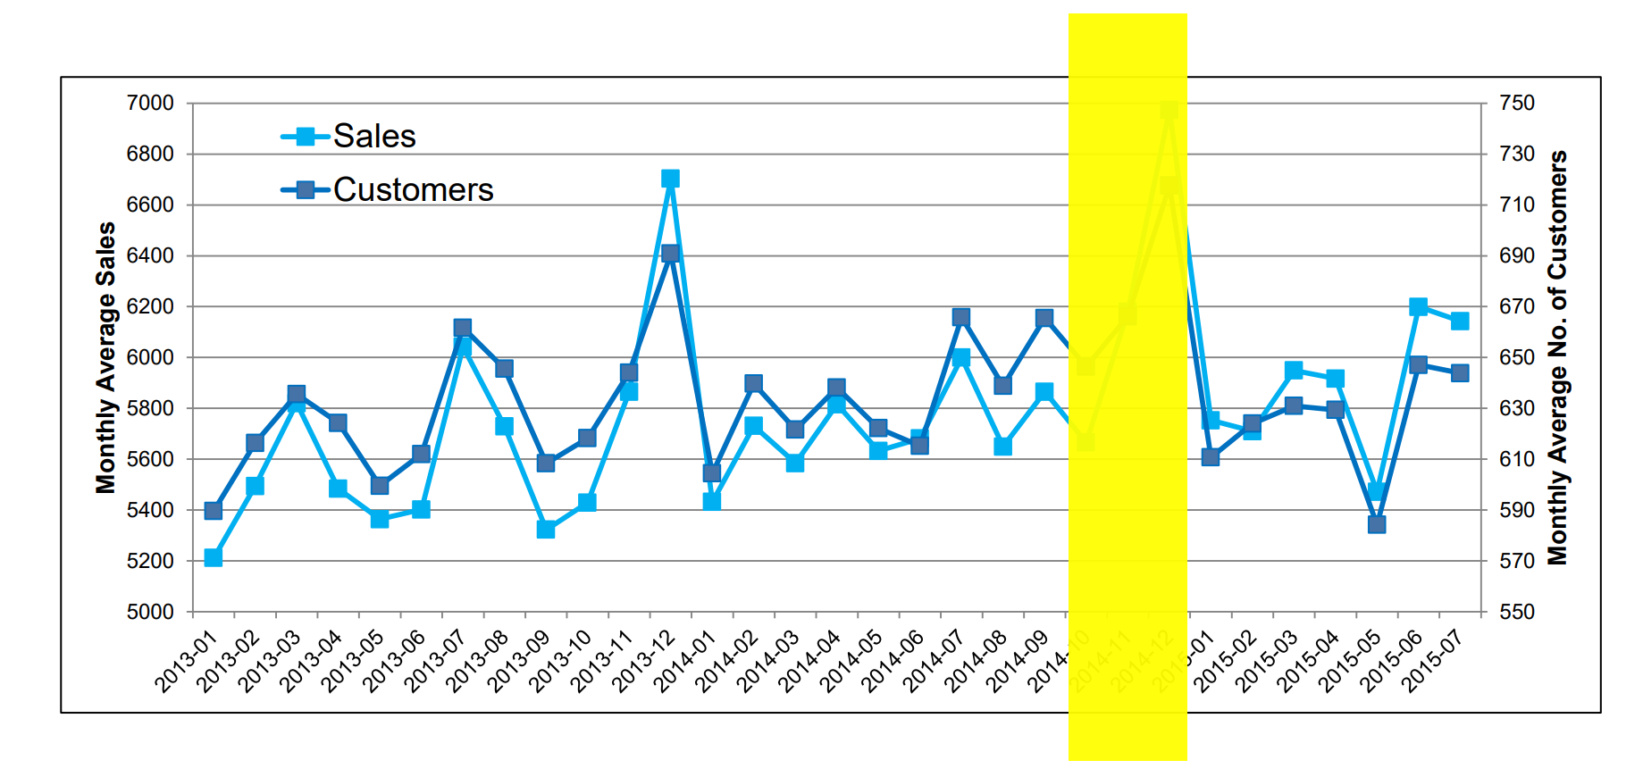
No Easy Fix – Time Series Data
How to find and impute these missing data?
Notes:
And here’s an example of how tricky the task can be. This is a time series data for xx and xx from xx to xx. Here we miss the information for oct, nov, and dec. Apparently we cannot just impute the values from the mean or median of the rest of records. As we know that dec might be a peak, higher than the rest. We can not just delete the three months as well. It seems that the best way is to get information from the same month of last year, even thought we cannot be 100% confident that 2014 has the same trend as 2013

Slide 27
How to Handle Noisy Data?
Binning and smoothing
Sort data and partition into bins (equal-width, equal-depth)
Smooth by bin means, median, or boundaries, etc.
Regression
Smooth by fitting the data into a function with regression
Clustering
Detect and remove outliers that fall outside clusters
Combined computer and human inspection
Detect suspicious values and check by human (e.g., deal with possible outliers)
Notes:
As with missing values, there are lots of reasons data can be noisy, which means with added error or variance that may or may not be random.
How to handle noisy data?
We can do Binning and smoothing. We can
Sort data and partition into bins, either by (equal-width or by equal-depth)
And then Smooth the data by bin means, median, or boundaries, etc.
We can also adopt Regression and Smooth the data by fitting the data into a function with regression
We can do Clustering to Detect and remove outliers that fall outside clusters
Last not but not least, we can Combine computer and human inspection to Detect suspicious values, e.g., deal with possible outliers. This is very common

Slide 28
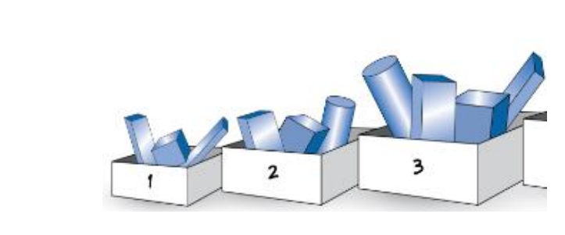
Binning Methods for Data Smoothing
Sorted data for price (in dollars): 4, 8, 9, 15, 21, 21, 24, 25, 26, 28, 29, 34
• Partition into 3 frequency (equal-depth) bins:
Bin 1: 4, 8, 9, 15
Bin 2: 21, 21, 24, 25
Bin 3: 26, 28, 29, 34
Smoothing by bin means:
Bin 1: 9, 9, 9, 9
Bin 2: 23, 23, 23, 23
Bin 3: 29, 29, 29, 29
• Smoothing by bin boundaries:
Bin 1: 4, 4, 4, 15
Bin 2: 21, 21, 25, 25
Bin 3: 26, 26, 26, 34
Notes:
Here I’d like to talk about xx in detail. Suppose that we have 12 Sorted data for price ranging from 4 to 34, we can partition them into 3 frequency (equal-depth) bins:
If we do Smoothing by bin means, so that xxx
Alternatively, if we Smooth by bin boundaries, so that xxx
In this way, we minimize the effects of small observation errors. We also reduce the chances of overfitting in case of small datasets

Slide 29
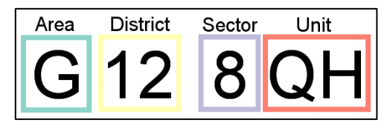
Other relevant concepts
Data scrubbing: use simple domain knowledge (e.g., postal code, spell-check) to detect errors and make corrections
Data auditing: analyse data to discover rules and relationship to detect violators (e.g., correlation and clustering to find outliers)
Data validating: value range checks, regular expressions, uniqueness checks
Notes:
Other concepts related to data cleaning include xx.
Unfortunately usually manual work is essential to cleaning the data, as a lot of common sense hasn’t been programmed. E.g., the postcode, you might have to check on your own to make sure that all postcodes are real, correct and accurate.
This usually take a lot of time and a lot of domain knowledge . And that's kind of explaining why data preprocessing can account for almost 80% of the work

Slide 30
Reduction

Slide 31
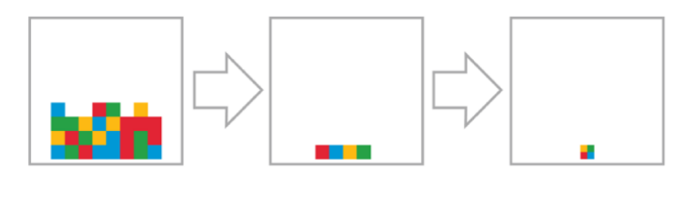
Data Reduction
Why data reduction?
A database/data warehouse may store terabytes of data
Complex analysis may take a very long time to run on the complete data set
Data reduction
Obtain a reduced representation of the data set - much smaller in volume but yet produces almost the same analytical results
Notes:
So Why data reduction?
Quite simple. In the age of Big data, A database/data warehouse may store terabytes of data, if not more.
Complex analysis may take a very long time to run on the complete data set, and usually come with significant computational complexity
Data reduction Means that people can Obtain a reduced representation of the data set - much smaller in volume but yet produces almost the same analytical results

Slide 32
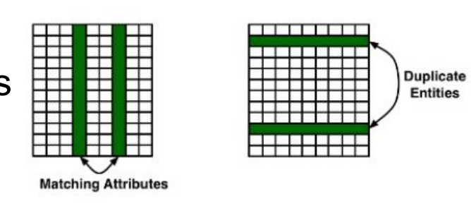
Data Reduction During Integration
Redundant data is often created when integrating multiple databases
Column-oriented: the same attribute may have different names in different databases
Row-oriented: duplicate entities, etc.
Notes:
Firstly, Data Reduction is almost always possible During data Integration
Redundant data is often created when integrating multiple databases
it can be either Column-oriented, as the same attribute may have different names in different databases
Or Row-oriented for duplicate entities, etc.
Therefore, Careful integration of the data from multiple sources may help reduce/avoid redundancies and inconsistencies and improve the efficiency and quality of data analytics.
Or just remember to check the shape of merged datasets at the end

Slide 33
Data Reduction Strategies
Dimensionality reduction
Remove redundant and irrelevant attributes
Principal component analysis (PCA)
Variable clustering
Featuring engineering
Numerosity reduction
Sampling techniques
Regression and log-linear models
Histograms, clustering
Notes:
There are two data reduction strategies.
First is Dimensionality reduction
Remove data with poor quality (e.g., many missing values, large number of categories, zero-variance)
Remove redundant and irrelevant attributes or variables
Principal component analysis (PCA), Variable clustering and/or Featuring engineering
Second is Numerosity reduction, or data reduction
We can adopt Sampling techniques, or do Regression and log-linear models so to just keep the model and abandon the data, or maybe Histograms and clustering
These methods are less common but still solutions to deal with large data size

Slide 34
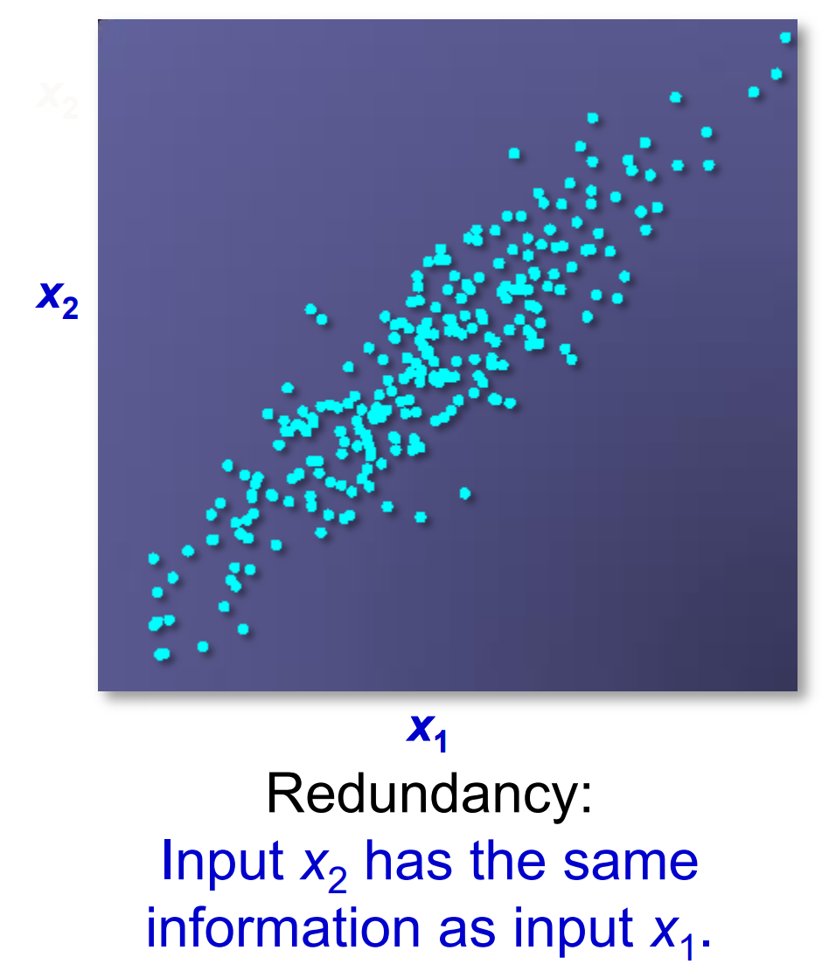
Variable Reduction – Correlation analysis
Notes:
Here’s an examples. we can see that Input X2 has the similar information as input X1, as they are positively correlated. If X1 has certain relation to the output, then we can just use x1 to approximate the relation between x2 and the output, and vice versa. In this sense 1 of them is actually redundant and we can just keep the other.

Slide 35
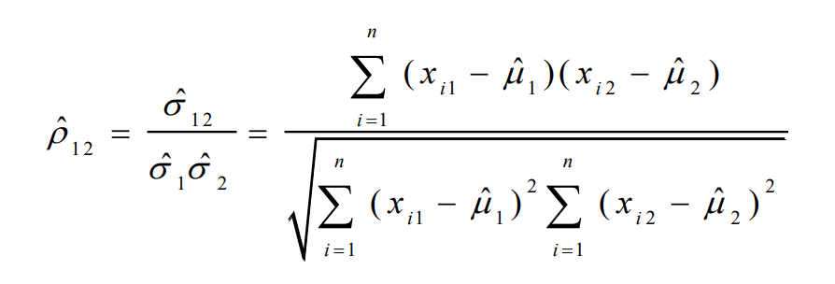
Correlation Analysis – Numerical Variables
Correlation between two variables x1 and x2 is the standard covariance, obtained by normalising the covariance with the standard deviation of each variable.
Sample correlation for two attributes x1 and x2: where n is the number of samples, µ1 and µ2 are the respective means, σ1 and σ2 are the respective standard deviation of x1 and x2
Notes:
So this is correlation analysis.
Correlation between two variables x1 and x2 is the standard covariance, obtained by normalising the covariance with the standard deviation of each variable.
Sample correlation for two attributes x1 and x2 can be computed with the following equation. where n is the number of samples, µ1 and µ2 are the respective means, σ1 and σ2 are the respective standard deviation of x1 and x2

Slide 36
Correlation Analysis – Numerical Variables
Sample correlation for two attributes x1 and x2: where n is the number of tuples, µ1 and µ2 are the respective means, σ1 and σ2 are the respective standard deviation of x1 and x2
If ρ12 > 0: x1 and x2 are positively correlated (x1 ’s values increase as x2 ’s increase)
If ρ12 = 0: independent
If ρ12 < 0: negatively correlated
Notes:
If ρ12 > 0: x1 and x2 are positively correlated (x1 ’s values increase as x2 ’s increase)
If ρ12 = 0: independent
If ρ12 < 0: negatively correlated

Slide 37
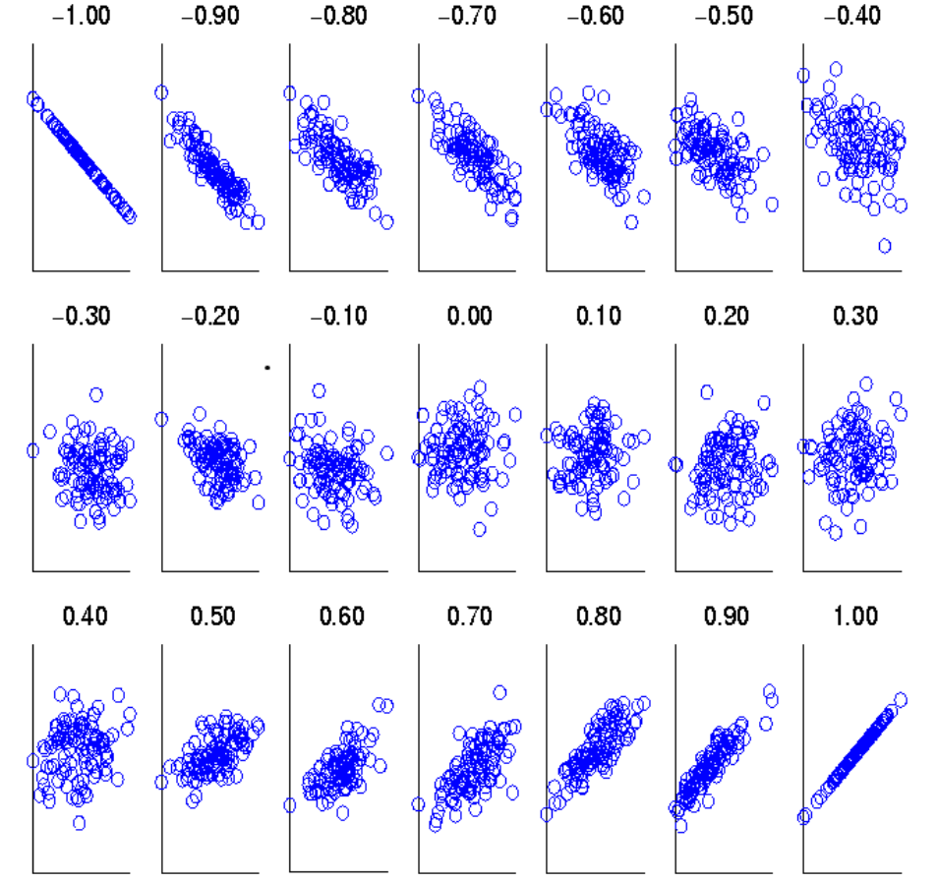
Visualising Correlation Coefficients
Correlation coefficient value range: [–1, 1]
Notes:
Correlation coefficient value range: [–1, 1]
These scatter plots demonstrate sets of points and their correlation coefficients changing from –1 to 1

Slide 38
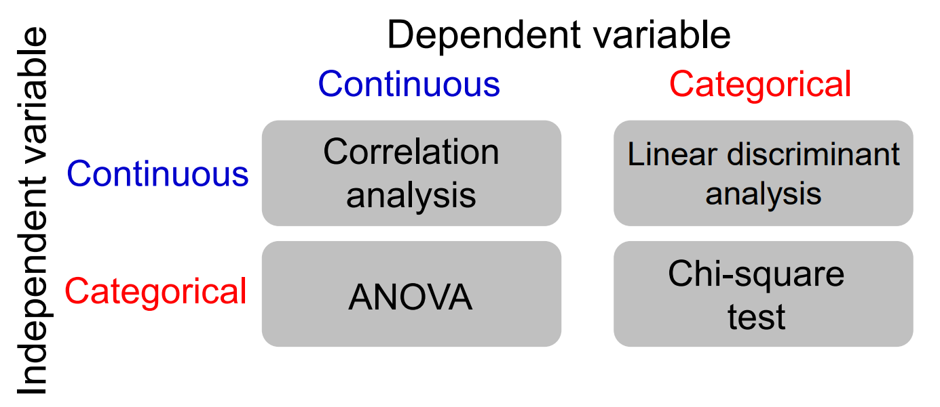
Correlation Analysis
Methods for testing correlation/ dependence/ association between independent and dependent variables
Notes:
Different Methods are used for testing correlation between different types of variables
If both variables are continuous variables, xx

Slide 39
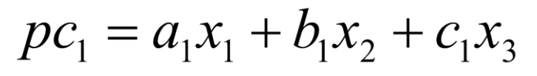
Variable Reduction – Principal Component Analysis
Principal components are constructed as mathematical transformations of the input variables. Each is an uncorrelated, linear combination of original input variables.
The coefficients of such a linear combination are the eigenvectors of the correlation or covariance matrix.
The principal components are sorted by descending order of the eigenvalues.
The eigenvalues represent the variances of the principal components.
Notes:
Principal components are constructed as mathematical transformations of the input variables. Each is an uncorrelated, linear combination of original input variables. The components can be written as a sum of loadings onto variables,
e.g. Xx, where e.g. a1, b1, c1 are called as loadings
The coefficients of such a linear combination are the eigenvectors of the correlation or covariance matrix.
The principal components are sorted by descending order of the eigenvalues.
The eigenvalues represent the variances of the principal components.
PCA is by far the most popular dimensionality reduction technique, especially if there are many many attributes, like million of attributes, then we can just use 100 PCs to capture their variance, as A small number of principal components can be kept to explain a lot of the variation in the data cloud.
But the disadvantage is that it’s Difficult or impossible to interpret the constructed principal components.

Slide 40
Numerosity Reduction
Non-parametric methods
Do not assume models
E.g. Sampling, clustering, histograms, etc.
Parametric methods
Assume the data fits some model, estimate model parameters, store only the parameters, and discard the data
E.g. regression, log-linear models
Notes:
In terms of numerosity reduction. On the one hand is Non-parametric methods, where we do not assume models. Common methods include Sampling, clustering, histograms, etc.
On the other hand is Parametric methods where we Assume the data fits some model, estimate model parameters, store only the parameters, and discard the data (except possible outliers) E.g. regression, log-linear models

Slide 41
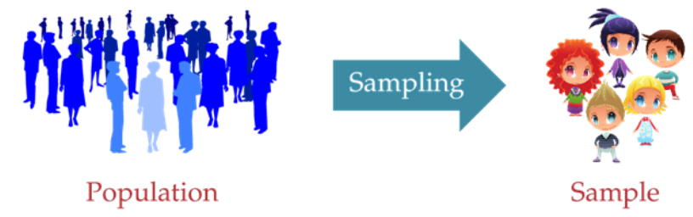
Sampling
Sampling: obtaining a small set of samples to represent the whole data set
Simple random sampling
Sampling without replacement
Sampling with replacement
Stratified sampling
Notes:
For the reason of time, I can just expand on Sampling methods, which is the most common one I think.
Sampling means obtaining a small set of samples to represent the whole data set (assuming that the computational complexity is potentially sub-linear to the size of the data)
Simple random sampling means There is an equal probability of selecting any particular object
Sampling without replacement means that Once an object is selected, it is removed from the population
Whereas Sampling with replacement means A selected object is not removed from the population
Last but not least is Stratified sampling: where it is required to Approximate the percentage of each class in the overall database before drawing the samples. It is usually Used in conjunction with skewed data

Slide 42
Transformation

Slide 43

Tidy data
Each observation has its own row.
Each variable has its own column.
Each value has its own cell.
Notes:
Consider the shape of the data – when we were joining tables, we made data wider – adding more columns. That is not a bad thing necessarily, but after joining you may want to reshape the data to by tidy. Tidy data is usually considered less wide because each observation has its own row. Let’s take a look.

Slide 44
Is it tidy?
Does each observation have its own row?
Does each variable have its own column?
Does each value have its own cell?
Country | Date | Incidents | Resolutions
UK | 22/04/2020 | 18 | 10
France | 22/04/2020 | 11 | 9
China | 22/04/2020 | 21 | 18
Notes:
This table is very human read-able and is a good way to present data for reporting. But is it tidy?

Slide 45
It is tidier now.
Each observation has its own row,
each variable has its own column,
And each value has its own cell.
Country | Date | Type | Counts
UK | 22/04/2020 | Incidents | 18
France | 22/04/2020 | Incidents | 11
China | 22/04/2020 | Incidents | 21
UK | 22/04/2020 | Resolutions | 10
France | 22/04/2020 | Resolutions | 9
China | 22/04/2020 | Resolutions | 18
Notes:
This table is tidier, which makes it better for analysis. As a consequence, it is not as human read-able and so is not as good an option for putting in a report or on a poster.
Can it be even tidier?
What about the date? Should it be broken into day month and year or not?

Slide 46
Data Transformation
A function that maps the entire set of values of a given attribute to a new set of replacement values
Relevant methods include Normalisation/ Standardisation: scale data to fall within a smaller, specified range
» min-max normalisation
» z-score normalisation
» normalisation by decimal scaling
Notes:
Data transformation is A function that maps the entire set of values of a given attribute to a new set of replacement values, Such that each old value can be identified with one of the new values. It’s very helpful and necessary if you have features at different scale, e.g. weight and income of a person. Many actions, like PCA requires normalisations in advance to guarantee their performance.
Relevant methods: is Normalisation/ Standardisation: which scales data to fall within a smaller, specified range, including
» min-max normalisation
» z-score normalisation
» normalisation by decimal scaling

Slide 47
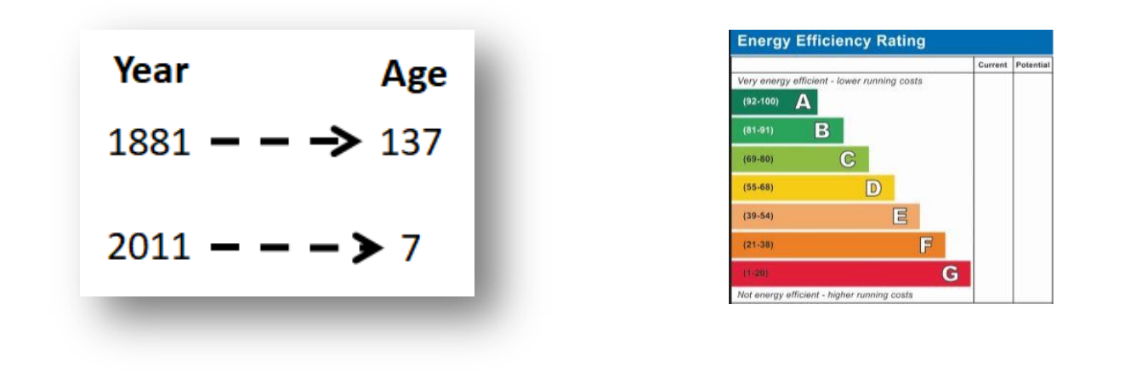
Data Transformation Examples
Standardise numeric values
Change counts into percentages.
Translate dates to durations.
Capture trends with ratios, differences, etc.
Replace categorical values with appropriate numeric values
Notes:
There are several different Data Transformation Methods, each for different purposes.
e.g. Standardise numeric values so that all numeric values are replaced by the notion of “how far is this value from the average?” Standardisation is useful, although it sometimes has no effect on the results (such as for decision trees and regression)
We can also Change counts into percentages, Translate dates to durations, Capture trends with ratios, differences, etc.
And also Replace categorical values with appropriate numeric values, as many techniques work better with numeric values
The example on the left is transform year into age if the current year is 2018. and on the left, the rating a to g can be transformed to the median scores of their respective band.

Slide 48
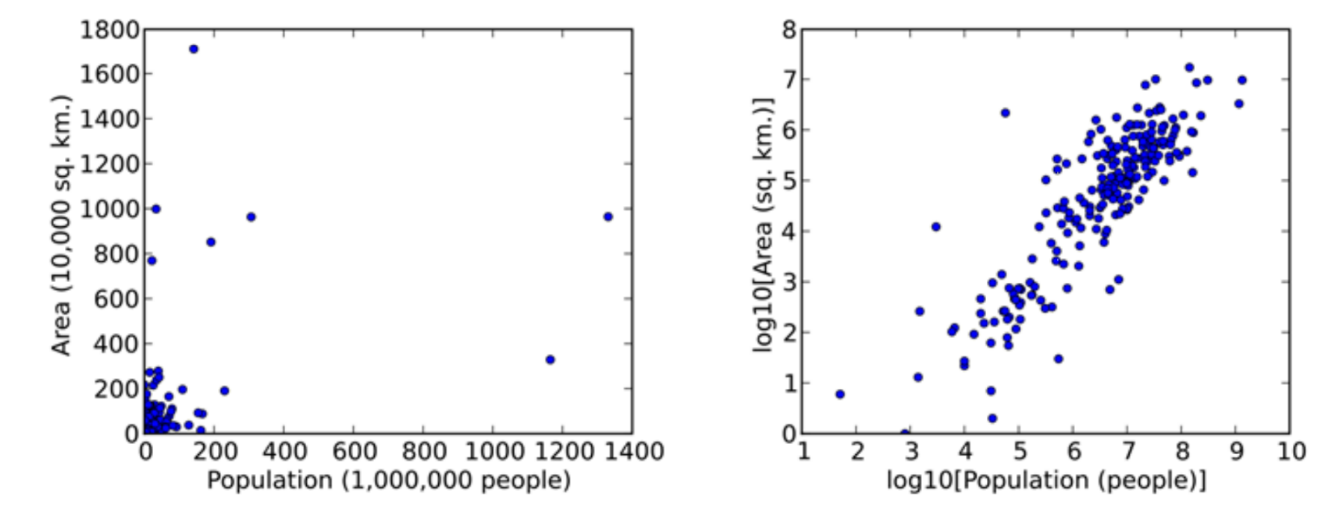
Data Transformation – Examples cont.
Transform variables to bring information to the surface.
Transform using mathematical functions, such as logs, reciprocal, or square root, for “stretching” and “squishing”
Notes:
We can also transform data bring information to the surface, simply by using mathematical functions, such as logs, reciprocal, or square root, for “stretching” and “squishing” data
Here’s another example of using logarithm to zoom in the patterns of the data.

Slide 49
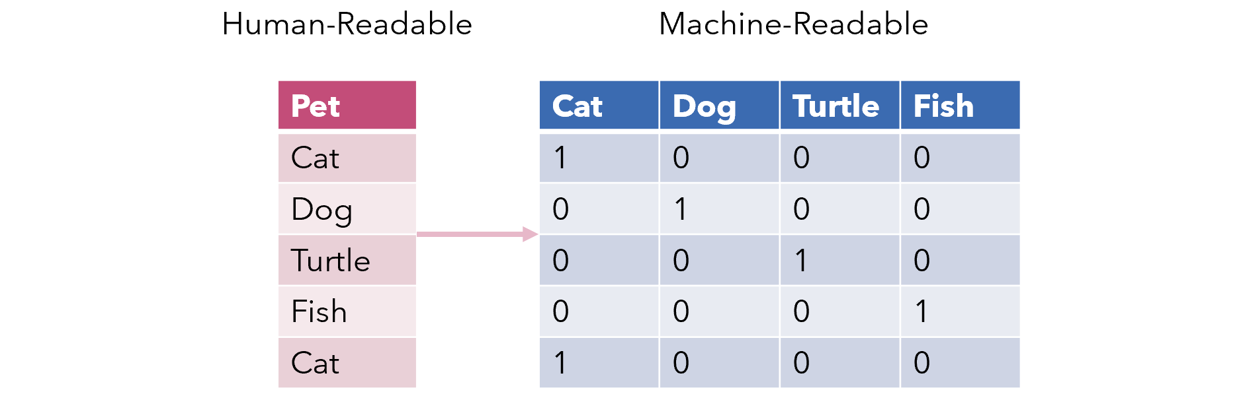
One-hot Encoding
Use binary variables to replace a categorical feature.
Notes:
One hot encoding is a very common data transformation. Where binary variables are used to replace a categorical feature
Some algorithms can work with categorical data directly.For example, a decision tree.
But Many machine learning algorithms cannot operate on label data directly. They require all input variables and output variables to be numeric. This means that categorical data must be converted to a numerical form. e.g. here the 4 categories are transformed into 4 new attributes.
If the categorical variable is an output variable, you may also want to convert predictions by the model back into a categorical form in order to present them or use them in some application.

Slide 50
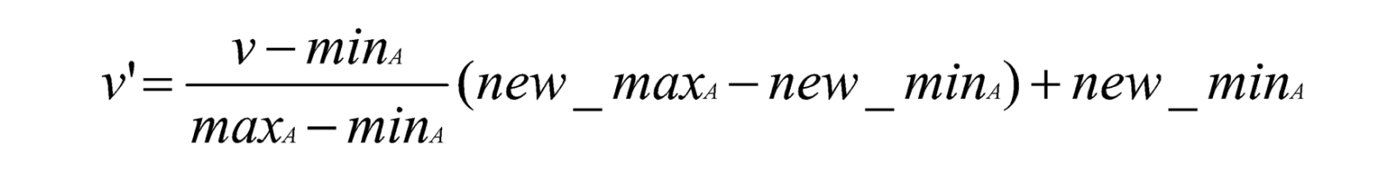
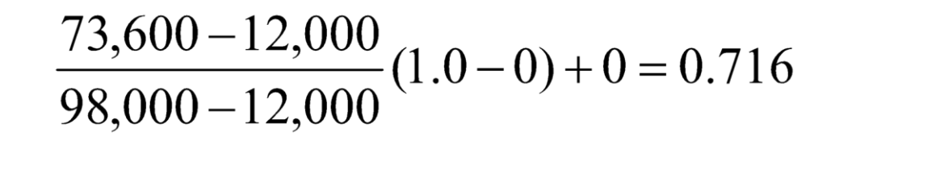
Min-Max Normalisation
min-max normalisation
Example – income, min £12,000, max £98,000 – map to 0.0 – 1.0
£73,600 is transformed to:
Notes:
Min-max normalization is one of the most common ways to normalize data. For every feature, the minimum value of that feature gets transformed into a 0, the maximum value gets transformed into a 1, and every other value gets transformed into a decimal between 0 and 1
For Example – if the min of income is £12,000, and the max is £98,000, then we map the two boundaries into 0.0 – 1.0, and thus £73,600 is transformed to: 0.716

Slide 51
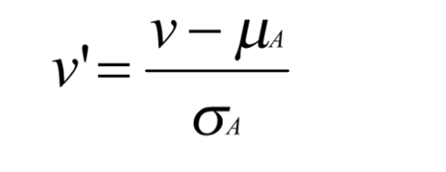
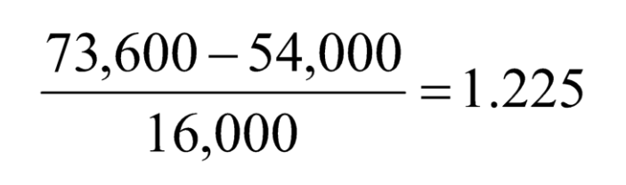
Z-score Normalisation
z-score normalisation (μ: mean, σ: standard deviation)
z-score: The distance between the raw score and the population mean in the unit of the standard deviation
Let μ = 54,000, σ = 16,000.
Notes:
Z-score normalisation is another common method. Simply put, a z-score (also called a standard score) gives you an idea of how far from the mean a data point is. But more technically it is The distance between the raw score and the population mean in the unit of the standard deviation
Given the example in last case, the mean is 54000 and std is 16000, therefore the income 73600 is transformed into 1.225

Slide 52
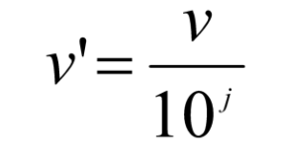
Normalisation by Decimal Scaling
Normalisation by decimal scaling
where j is the smallest integer such that Max(| v’|) <1
Example — recorded values from -722 to 821
Divide each value by 1000
-28 normalised to -.028
444 normalised to 0.444
Notes:
Last but not least is normalisation by decimal scaling. It’s relatively more straightforward. The new value is equal to the old value divided by 10 to the jth power where j is the smallest integer such that Max of the absolute value of v’ is smaller than 1
e.g. given a set of values ranging from -772 to 821, we can divide each value by 1000 and then -28 is normalises to -.028 and 444 normalises to 0.444

Slide 53
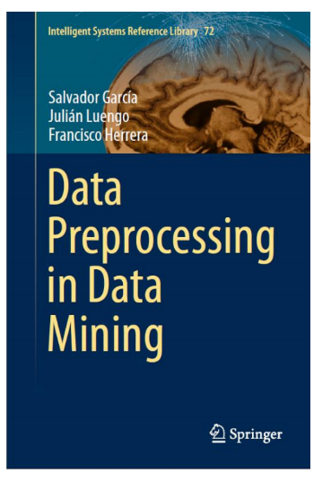

Acknowledgement
Some of the content is based on …
García, S., Luengo, J. and Herrera, F., 2015. Data preprocessing in data mining New York: Springer.
Yu-wang Chen. “Understanding Data and Their Environment- Data Preprocessing” (2019)

Slide 54
Any questions?
?

Slide 55
Thank you.

